Slide 1

SESHADRI RAO GUDLAVALLERU ENGINEERING COLLEGE
Department of Computer Science and Engineering
MAIN PROJECT on
OBJECT IDENTIFICATION AND RECOGNITION SYSTEM FOR A BLIND PERSONS
Under the guidance of
Mrs.P.Naga Mani, M.Tech(Ph.D)
Assistant Professor, Department of CSE
By
19481A05E8
19481A05H7
19481A05F4
19481A05E7

Slide 2
CONTENTS
Objective
Abstract
Existing System
Proposed System
Hardware and Software Requirements
Block Diagram

Slide 3
Objective
To develop a system that can identify surrounding objects to the blinded people and notify the users.
To identify a set of objects used in everyday routine thereby enabling them to work independently.

Slide 4
ABSTRACT
Visual impairments have become one of the most predominant problems in the last few decades. To keep doing their daily tasks, they usually seek help from others.
An automated common object recognition system can improve safe movement. To develop a system that can identify surrounding objects and notify them.
The aim of the system is to assist blind Persons to detect objects using image processing and provide audio output to identify the objects.

Slide 5
It takes an image of the object as input and identifies the object
Identification of Object presence is based on object detection by open cv
Limited memory and very less processing time available to achieve real-time image-processing requirements

Slide 6
EXISTING SYSTEM
In the existing system YOLO algorithm is used to recognize the object .
It is difficult to identify objects that are not present in the data set.
DISADVANTAGES:
It is not possible to recognize the objects that are not present in data set
.

Slide 7
PROPOSED SYSTEM
In the proposed system the object is automatically detected by the sensor and image is recognized by using OpenCV .
This method helps to recognize all kinds of object.
ADVANTAGES
Blind person easy to identify objects.
Prevent accident

Slide 8
Open CV
OpenCV (Open Source Computer Vision Library) is an open source computer vision and machine learning software library. OpenCV was built to provide a common infrastructure for computer vision applications and to accelerate the use of machine perception in the commercial products. Being an Apache 2 licensed product, OpenCV makes it easy for businesses to utilize and modify the code.

Slide 9
HARDWARE REQUIREMENTS
RASPBERRY PI
LCD
APR VOICE MODULE
SPEAKER
CAMERA
SD CARD
WI-FI

Slide 10
SOFTWARE REQUIREMENTS
python
Raspberry PI IDE
Open CV

Slide 11
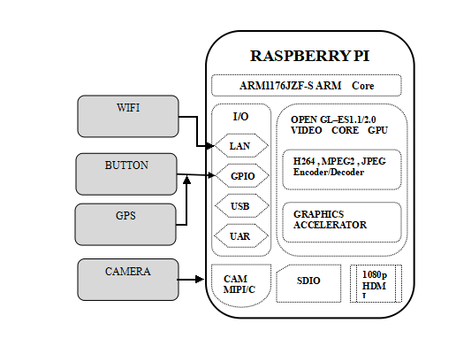
BLOCK DIAGRAM

Slide 12
Components
SDIO : SDIO may refer to: Secure Digital Input Output, a type of Secure Digital card interface. It can be used as an interface for input or output devices.
GPIO :GPIO stands for General-Purpose Input/Output. These pins are a physical interface between the Raspberry Pi and the outside world. At the simplest level, you can think of them as switches that you can turn on or off (input) or that the Pi can turn on or off (output).
CAM MIPI: A widely adopted, high-speed protocol for transmission of still and video images from image sensors to application processors

Slide 13
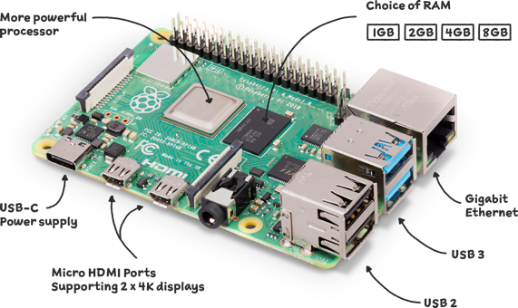

Slide 14
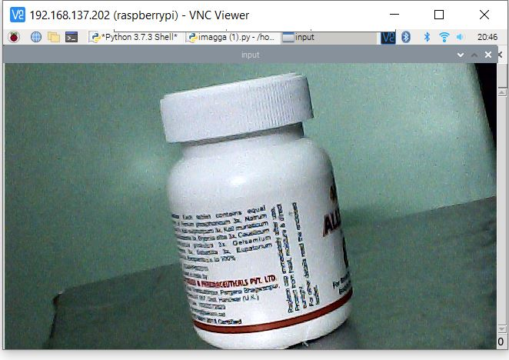
RESULTS

Slide 15
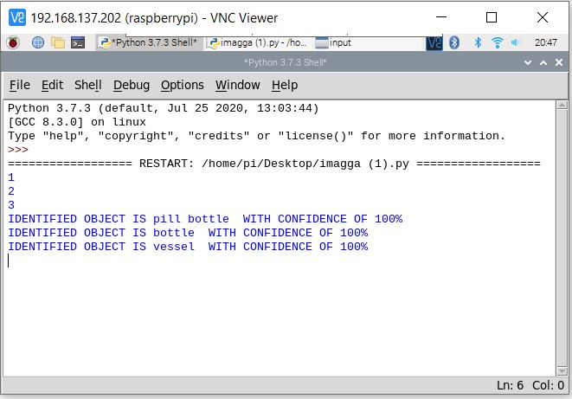

Slide 16
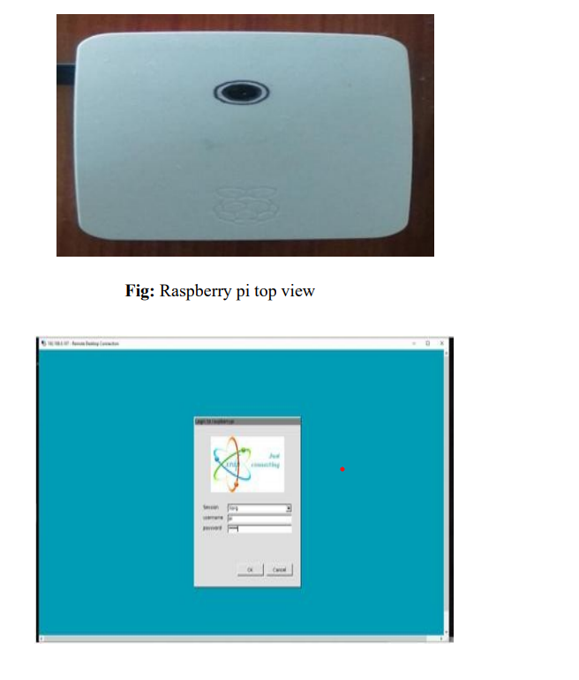

Slide 17
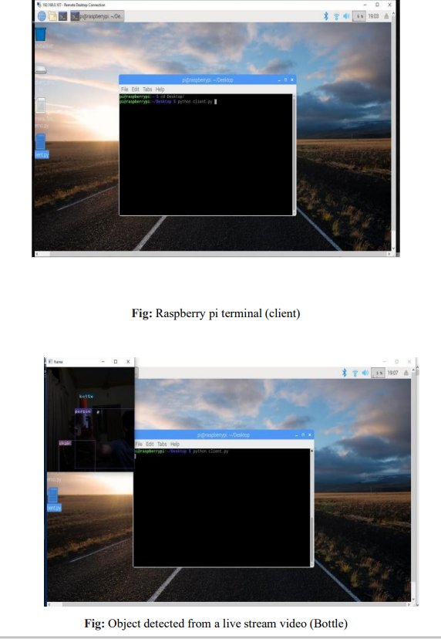

Slide 18
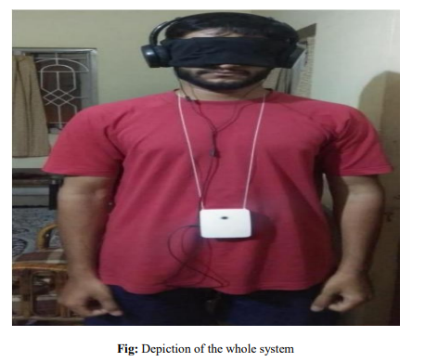

Slide 19

This Photo by Unknown Author is licensed under CC BY

